Slide 1
Did You Know…………………….
Date: November 11-13, 2014
Atlanta, GA.
Notes:
In case of Emergency
Phone on Vibrate - please leave room if necessary
Getting Started…
What do you do for your Company?
What do you hope to gain from this Seminar?

Slide 2
What Are We Hearing from U.S. Manufacturing Companies
Most Important Issues:
  Cost Reduction + Productivity Initiatives
  Employee Training
  New Technology in Operations
  Equipment Service for Advanced Fabrication
  Argon Shortage, Allocations
Do these issues look familiar? What are Your most Important Issues?
Sources: 1. 2013 ITW + Hypertherm End User Surveys
2. Airgas Account Feedback
Unlocking the Hidden Cost of Welding

Slide 3

Where are we headed together??
Are we taking the slow lane again??
Most procurement teams can influence price but not mix or consumption
  Potential gain with price focus is1-5%
About 1/3rd of these procurement teams use TCO’s with their vendors
  Potential gain when pulling multiple savings levers is 15-25%
  Source: Bain & Company
  A Fresh Look at Procurement - Jan 2012
Unlocking the Hidden Cost of Welding

Slide 4
Efficiency Analysis as a Blood Test
The EA begins as a data gathering exercise
Purchasing Department activity
  Gas purchases.
  Wire purchases.
  Purchase quantities for contact tips, nozzles, diffusers, liners, anti-spatter spray, torches and grinding wheels.
Shop Floor activity
  Do a Walk through – understand type of welding and number of welders
Crunch the numbers to see the health of the “system”
  Compare information with the Airgas dBase
  Benchmark / Quantify opportunities for improvement
Unlocking the Hidden Cost of Welding

Slide 5
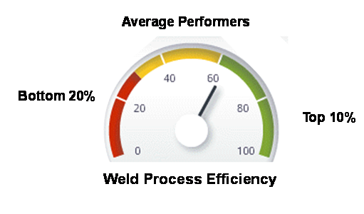
Did You Know…………………..
Productivity at an average welding operation can be improved by 20% with little or no capital investment
The average operation is PURCHASING 2 – 3x’s the Shielding Gas required
  We have found this is not only an issue with the cost of the gas but also the gas mix used. The gas mix and gas quality can have a significant impact on the amount of rework generated
Unlocking the Hidden Cost of Welding

Slide 6
Exercise with Gas to Wire Ratios
ABC Company
XYZ Company
Components for ABC
  Wire purchased
    35,848 Lbs .045 E71T-1
  Argon purchased = 681,864 c/f
  CO2 purchased = 527,703 c/f
Blood Test (Ratios)
  681,864 + 527,703= 1,209,567 c/f
  1,209,567 / 35,848 = 33.74
    One lb wire to 33.74 c/f shield gas
  527,703 / 1,209,567 = 43.6% CO2 Purchased
Components for XYZ
  Wire purchased
    429,600 Lbs .045 ER70S-6
  Argon purchased = 5,176,301 c/f
  CO2 purchased = 578,807 c/f
Blood Test (Ratios)
  5,176,301 + 578,807= 5,755,108 c/f
  5,755,108 / 429600 = 13.4
    One lb wire to 13.4 c/f shield gas
  578,807 / 5,176,301 = 11% CO2 Purchased
Which Ratio is Better??
Unlocking the Hidden Cost of Welding

Slide 7
Here’s what happens with the Ratios
Company ABC
  WPS calls for 75% Argon 25% CO2 (Purchased 43.6% CO2)
  WPS States 45 cfh gas flow with a amperage of 200A or 7.5 lbs per hour melt off rate
  The Gas to wire ratio should be 45cfh / 7.5 lbs/Hr = 6 or 1 : 6 it is 1 : 33.7
  4780 *45= 215,100 so 1,209,567-215,100= 994,467 c/f loss
  Total Spend $42,334.85 with a loss of $34,806.35
Company XYZ
  WPS call for 92% Argon 8% CO2 (Purchased 11% CO2)
  WPS states 35 cfh gas flow with wire feed speed of 370 ipm .045 wire (10 lbs per hr melt off rate)
  The Gas to Wire Ratio should be? 35 cfh / 10 lbs/hr = 3.5 or 1 : 3.5 it is 1 : 13.4
  42960*35=1503600 so 5755108-1503600= 4251508 c/f loss
  Total Spend $ 201,428.78 with a loss of $ 148,802.78
Unlocking the Hidden Cost of Welding

Slide 8
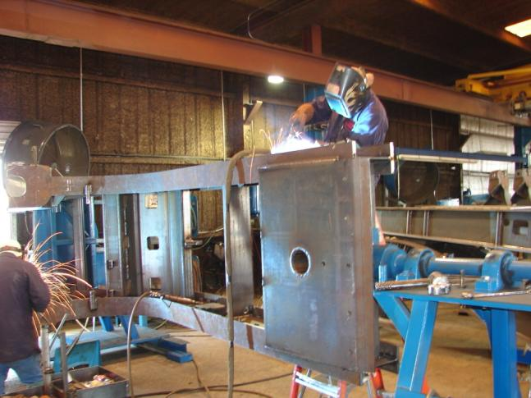
And Did you Know…………….
The average time welders have their “arc on” and are actually welding is only 9 minutes / hr
  The top 20% of companies reviewed are welding more than 18 minutes per hour.
  The average company welding 9 min per hour will spend 50% more.
Unlocking the Hidden Cost of Welding8

Slide 9
Operator Factor - $ / yr. savings
GMAW - “MIG”
10 welders
27.00 $/hr
1/4” Fillet – 8.8 lb / hr
Operator Factor - 15%
3 min
per hr
Operator Factor - 20%
Travel Speed - 14 ipm
Cost – 597,727.74 $ / yr.
Travel Speed - 14 ipm
Cost – 460,298.31 $ / yr.
137,429.43 $ / yr. or 5090 hrs or 2 people
Unlocking the Hidden Cost of Welding
Notes:
8

Slide 10
Did You Know a WPS can cause Over Welding
Specified
Fillet Weld Volume
Leg Size (lb/ft) *
Actual
Fillet Weld Volume Leg Size (lb/ft) *
Over Weld
%
1/8 0.027 3/16 0.060
122%
3/16 0.060
1/4 0.1065
77.5%
1/4 0.1065 5/16 0.166
56%
*Fillet leg size is for Theoretical Weld Volume per foot
Unlocking the Hidden Cost of Welding
Notes:
9

Slide 11
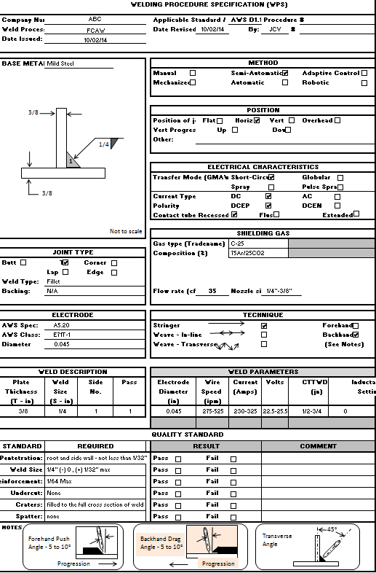

Slide 12
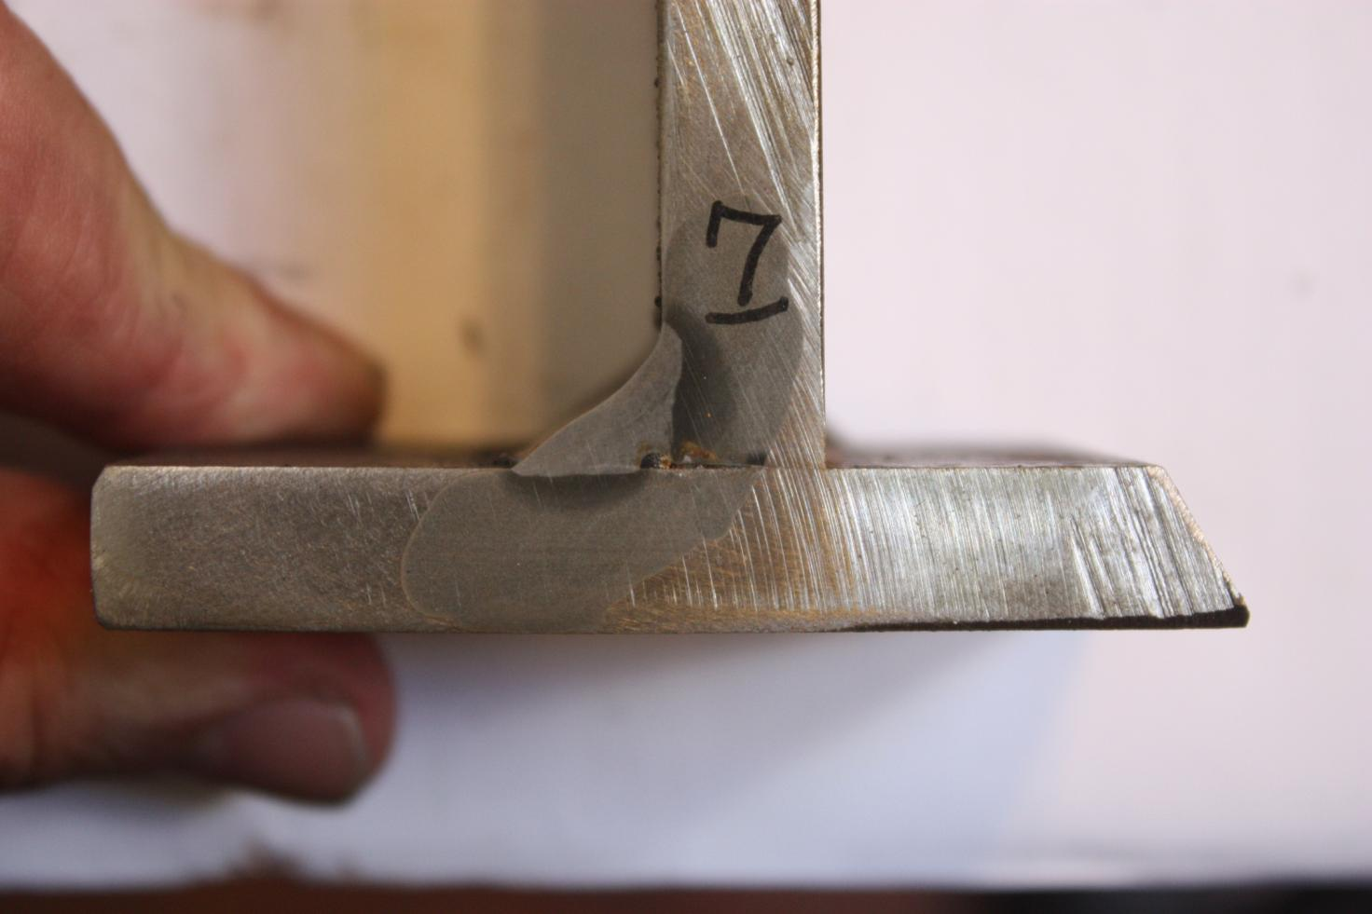
.045 71T-1, 75% Ar / 25% CO2 @ 35 CFH, 23 Volts, 230 Amps @ 275 WFS Weld Size .250/.3125 Travel Speed 7 ipm, Heat input 45.02 kj/in

Slide 13
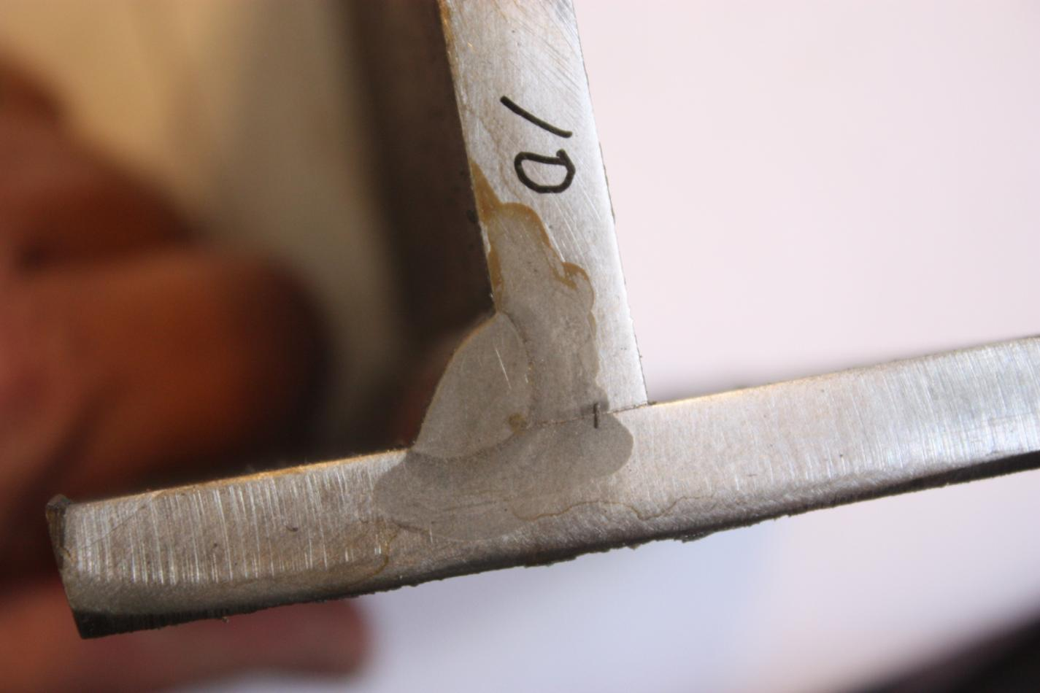
0.045 E71T-1, 75% Ar / 25% CO2 @ 35 CFH, 25.5 Volts, 325 Amps @ 525 WFS, Weld Size .250/.250, Travel Speed 11.5 ipm, Heat input 43.2 kj/in

Slide 14
Did you know ,,,,,,,,,,,,,,,,,,,?
GMAW - “MIG”
10 welders
27.00 $ / hr
¼” by 5/16” Fillet
¼” Fillet
Travel Speed – 7 ipm
Wire Feed Rate – 6.7 #/Hr
Cost: $782,782.00/yr
Travel Speed – 11.5 ipm
Wire Feed Rate – 12.8 #/Hr
Cost: $488,037.00/yr
$294,745/yr or 10,400 hours 4 less people
Unlocking the Hidden Cost of Welding
Notes:
13

Slide 15
Do you Know …………..
How your Business Stacks up compared to your Competition
Is your welding System Costing you $$$$$
We have A Large Database to measure the Health of your Welding Systems
Do You Know Where Your Hidden Costs are???
Did you Know Airgas has 80 AWS Certified Advanced Fabrication Specialists
And did you know We want to Help YOU Compete
Call 1-800-548-0909 for Your Blood Test

